Slide 1

Co-Authorship Network in Bangladesh
Course: CSE 6413
Submitted to:
Prof. Dr. Md. Saidur Rahman
Date: 01/02/2024

Slide 2
Team Members
Name | ID
Dipta Justin Gomes | 0424054005
Md. Nurul Muttakin | 0424054601

Slide 3
Presentation Outline
Introduction
Motivation
Contributions
Literature Review
Methodology
Results & Discussion
Conclusion
References

Slide 4
Introduction
Research community in Bangladesh is in a fast growing state, requiring an empirical study
Collaboration among researchers are mainly carried out based on institutions
Some notable researchers have contributed significant contributions within the last couple of years
Research based on institutions and among institutions have been the primal concern

Slide 5
Presentation Outline
Introduction
Motivation
Contributions
Literature Review
Methodology
Results & Discussion
Conclusion
References

Slide 6
Motivation
Understanding research relationships and collaboration hubs
Identifying key researchers and collaborative trends in the country
Supporting future research collaborations
Finding inconsistencies among research groups
Identifying Computer science as the primal focus of research (Kalhor et al, 2022)
Research based on finding key research fields, highly cited authors has been carried out by (Dania et al. ,2023) from Google Scholar lacking network analysis.
Co_authorship in Bangladesh has been carried out using BibliometrixR package by (Jalal and Samir , 2019) using VOSviewer.

Slide 7
Presentation Outline
Introduction
Motivation
Contributions
Literature Review
Methodology
Results & Discussion
Conclusion
References

Slide 8
Contributions
Compiled the dataset of research collaborations among researchers in the field of Computer Science in Bangladesh from verified University websites
Performed Network Analysis on the Network Obtained.
Proved the Network Scale Free Property
Performed Degree Co-relation Analysis
Detecting Communities co-existing in the network

Slide 9
Contributions
List of Universities considered:
Bangladesh University of Engineering and Technology (BUET)
Dhaka University (DU)
Chittagong University (CU)
Khulna University (KU)
Shahajalal University of Science and Technology (SUST)
Jahangirnagar University (JU)
Brac University
North South University (NSU)
Chittagong University of Engineering and Technology (CUET)
Khulna University of Engineering and Technology (KUET)
American International University-Bangladesh (AIUB)

Slide 10
Presentation Outline
Introduction
Motivation
Contributions
Methodology
Results & Discussion
Conclusion
References

Slide 11
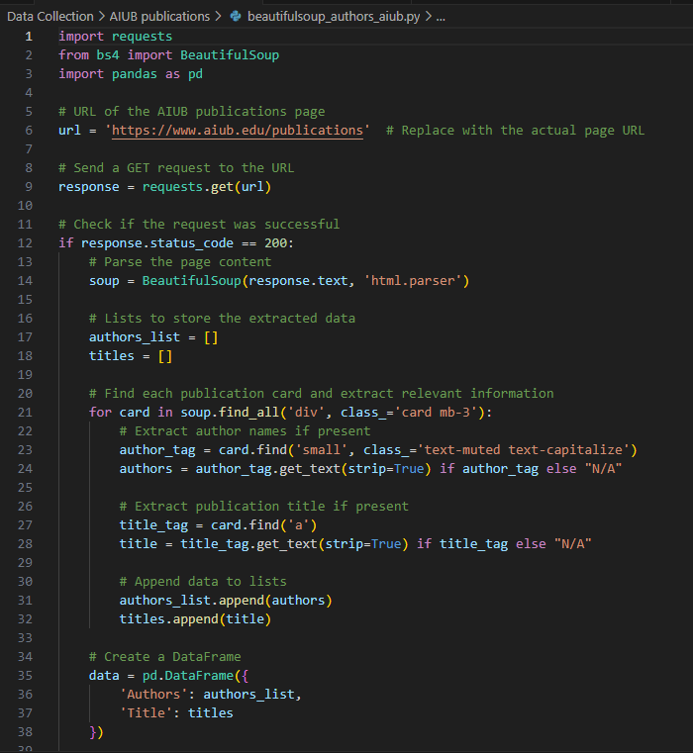
Methodology (Dataset Preparation)
Step 1: Data Retrieval
Retrieving research data from each Institutional website
Using the python libraries requests and BeautifulSoup to webscrap from the websites
Each website is composed of different structure of publication details, some other approaches involved text mining and bibtex file processing to obtain research data
The publication details, author list and research title is stored in a csv file format

Slide 12
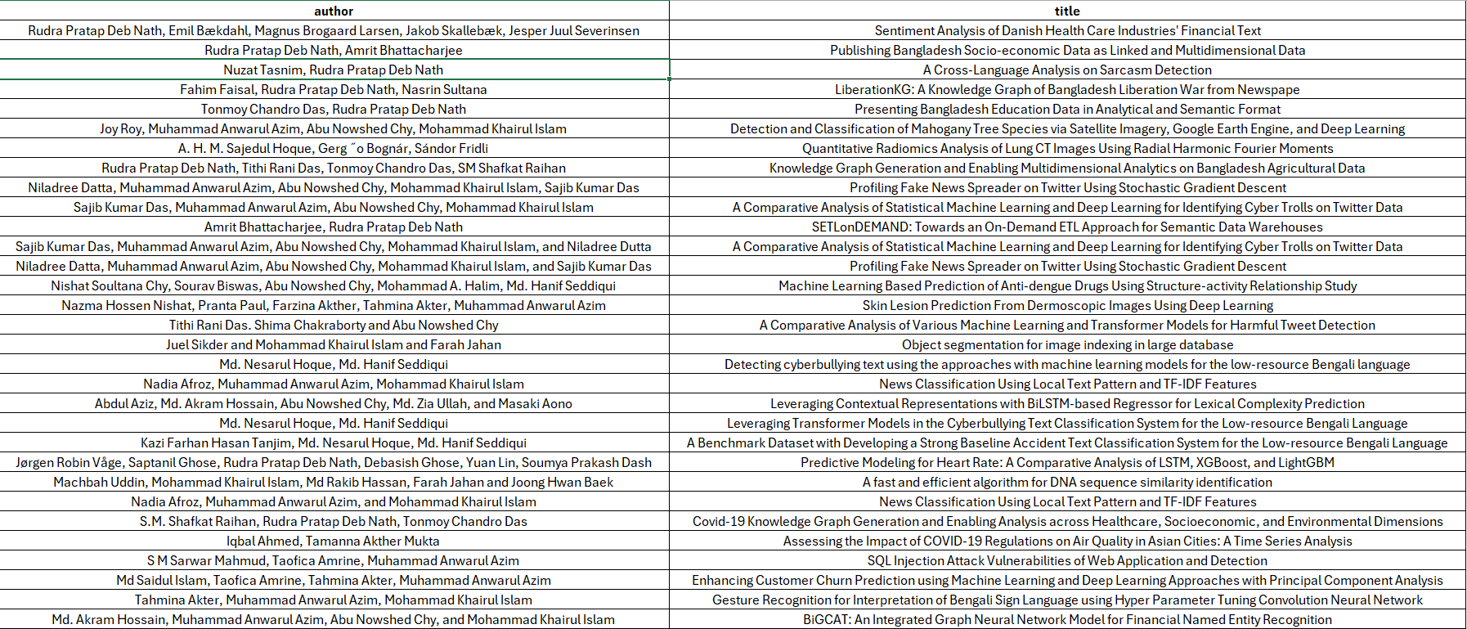
Dataset Preparation
Author-list and research title dataset for CUET

Slide 13
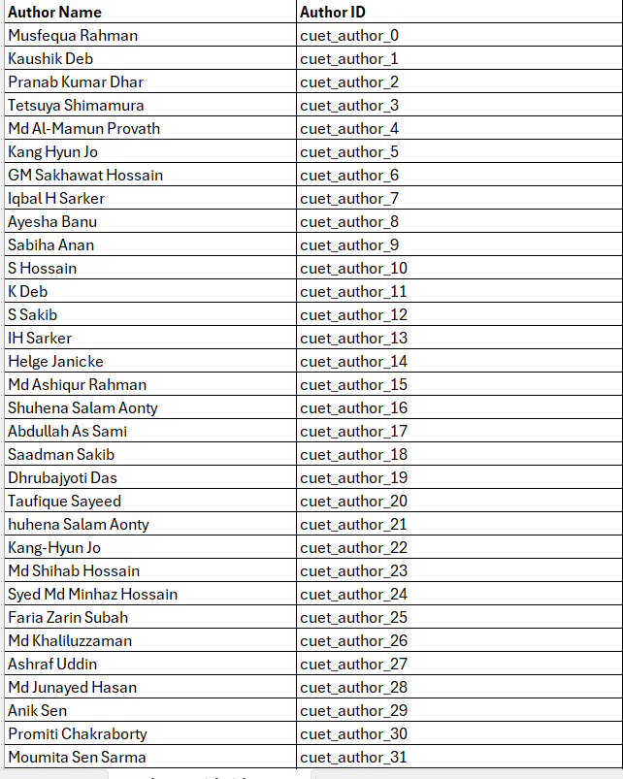
Dataset Preparation
Step 2: Assigning Author ID and Paper ID
Each Author List contain comma separated author names
Obtaining the author dataset containing author name and author_id (Author ID is represented in the form Ins_author_ID)
Obtaining the dataset containing author_id, paper_id and paper title to link collaborated authors
Author Dataset for CUET

Slide 14
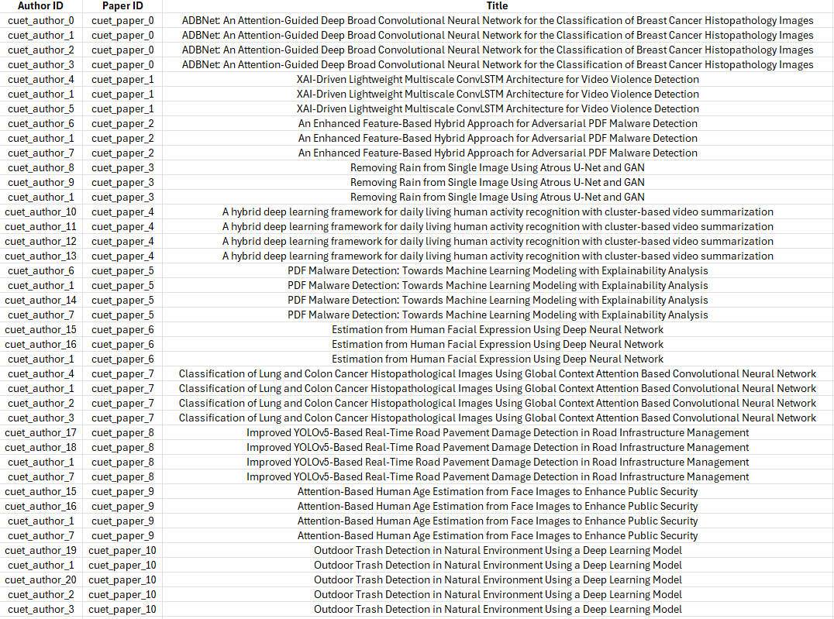
Dataset Preparation
Authorship and Paper_ID mapped Dataset

Slide 15
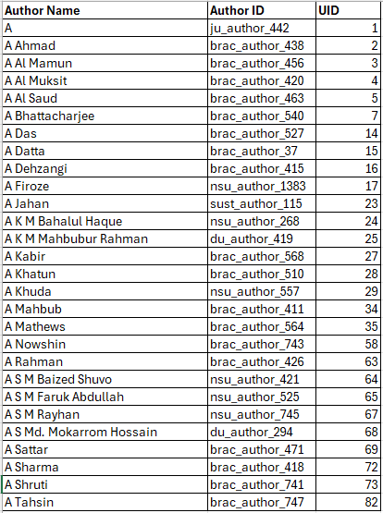
Dataset Preparation
Step 3: Merging the Author and Paper Dataset of each Institution and assigning each author an unique universal id (UID), sorted alphabetically

Slide 16
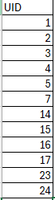
Network Design
Node Generation
From the merged Author and Paper dataset along with assigned UID, a node dataset is designed containing only the author UID for each unique authors.

Slide 17
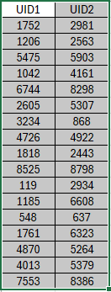
Network Design
Edge Generation
Map UID of each collaborative authors having the same paper_ID
Storing paper authors in a dictionary known as paper_authors
Group papers as per the paper_id. Authors with same papers ids are considered to be an edge
Generating unique author uid pairs per paper

Slide 18
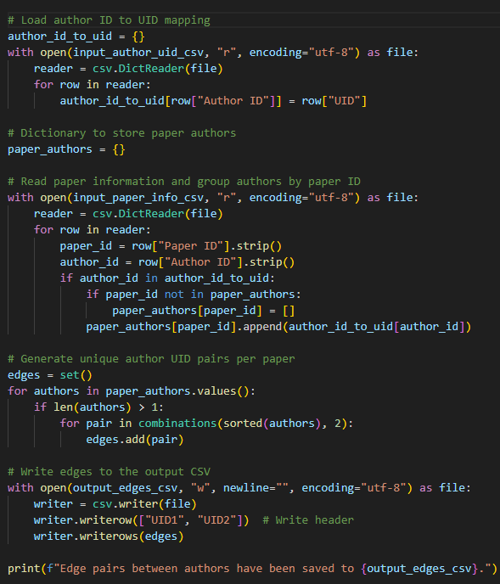
Network Design (Edge Generation)

Slide 19
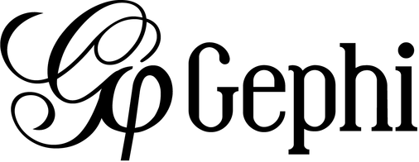
Network Generation
Using the Graph Generation Tool Gephi version: 0.10 to condtruct the co-authorship network.
Here the nodes are considered from the node and edges from the edge pair csv files.
Total number of detected unique nodes are 6300 and total number of edges in between the nodes are 17142

Slide 20
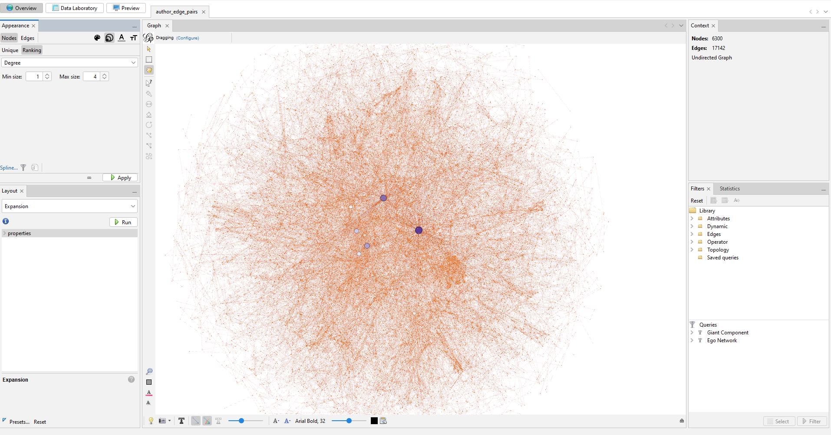
Network Generation (Gephi)

Slide 21
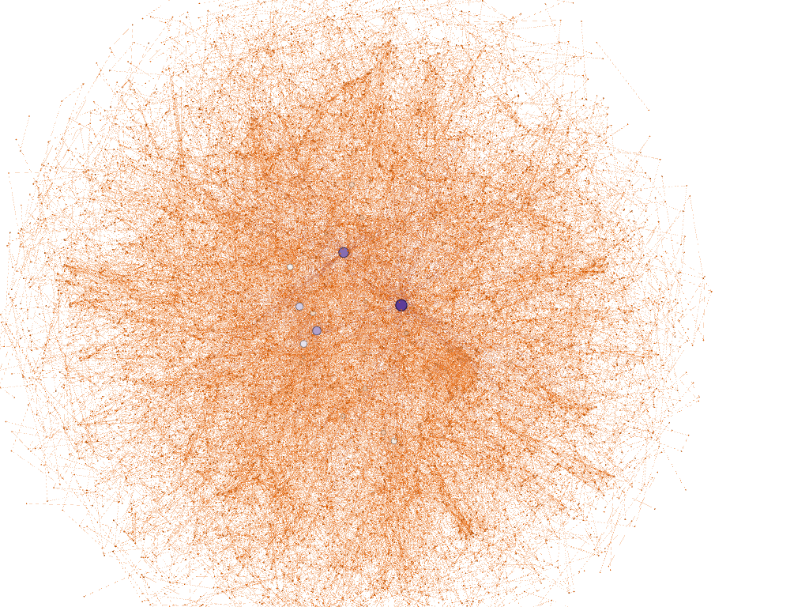
Generated Network

Slide 22
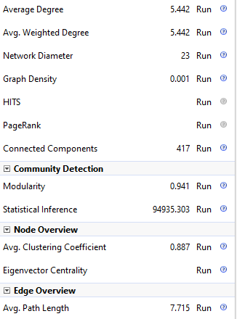
Network Properties obtained from NetworkX

Slide 23
Presentation Outline
Introduction
Motivation
Contributions
Methodology
Results & Discussion
Conclusion
References

Slide 24
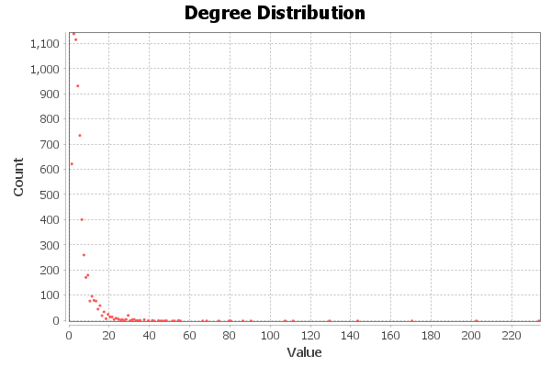
Results (Network Analysis)
Using NetworkX in Python to analyse the network
Degree Distribution
Less numbers of high degree nodes
The first figure represents the count

Slide 25
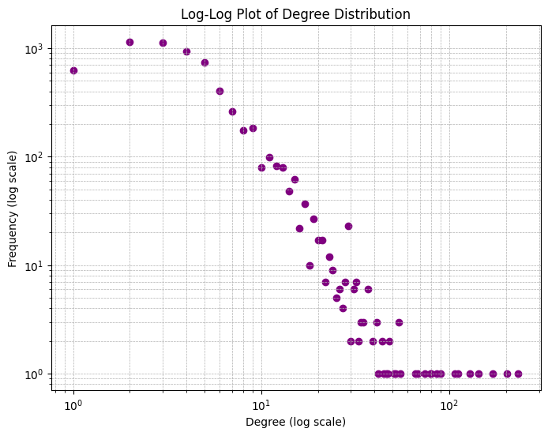

Slide 26
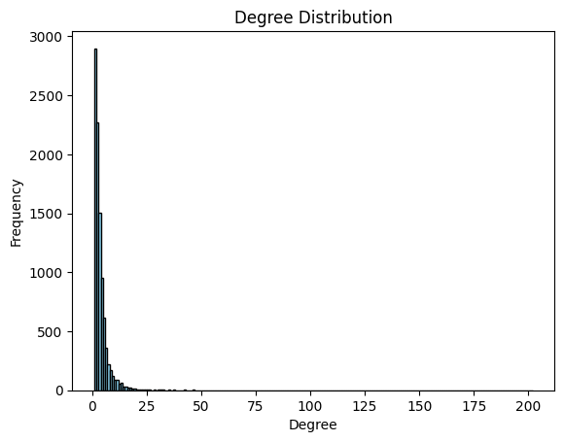

Slide 27
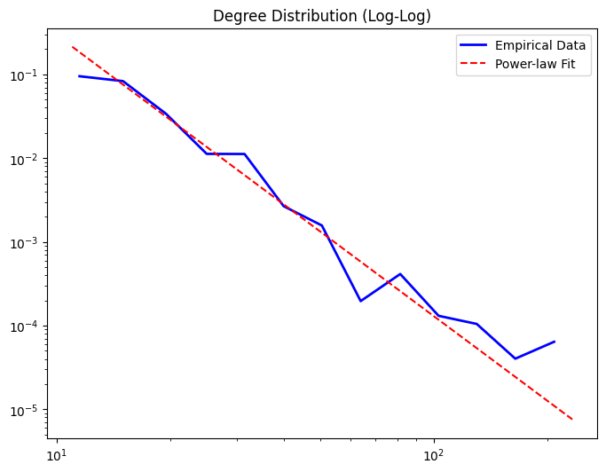
Degree Distribution Analysis (Power Law fit)

Slide 28
Degree Distribution Analysis (Power Law fit)
Gamma Value (γ) = 3.36
Indicates that the network is less dominated by hubs compared to typical scale-free networks (2< γ <3).
The degree distribution is still skewed, but hubs are not as disproportionately influential
While still possibly a scale-free network, it might be moving toward a semi-random structure resembling Poisson-like distributions found in Erdos-Rényi graphs.
Implications
Collaboration is relatively evenly distributed, without a few researchers dominating the entire network.
Higher resilience against targeted attacks compared to networks with smaller γ values

Slide 29
Hub Detection
Hubs with highest degrees found are:
5 hubs: [(4013, 0.03700174686358584), (989, 0.032078767667143085), (5867, 0.026996982690169924), (4333, 0.022709226615848815), (2926, 0.02048594568842306)]

Slide 30
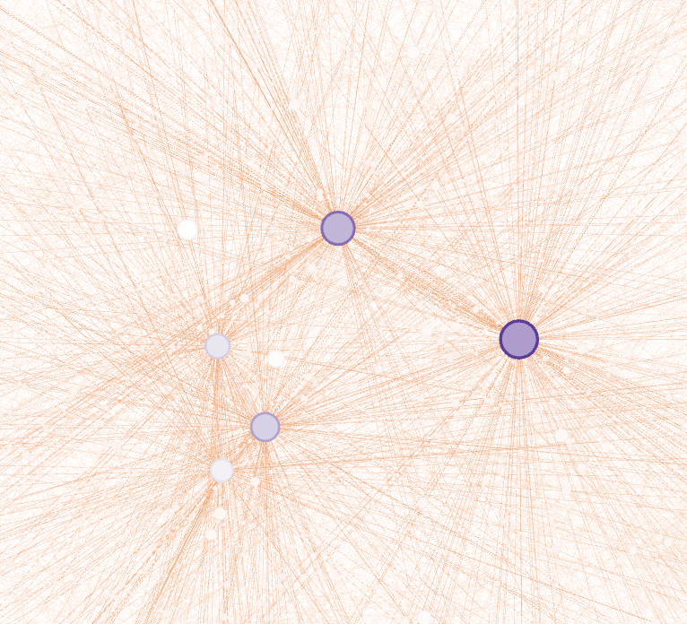
Hub Detection
Hubs with highest degrees found are:
These nodes often represent key researchers in co-authorship networks.
UID | Degree
4013 | 233
989 | 202
5867 | 170
4333 | 143
2926 | 129

Slide 31
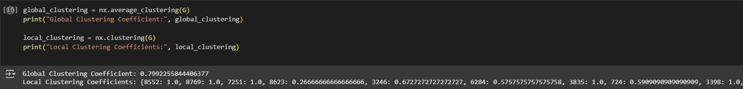
Measuring Local and Global Clustering Co-efficient
Global Clustering Coefficient: 0.7992255844406377
A value of 0.799 suggests that the network has a high level of clustering.
This means that a significant proportion of the node's neighbors tend to be connected to each other, forming closed loops or triangles.
It indicates a strong local network where researchers (nodes) in the network often collaborate with other researchers who already have connections, reinforcing tightly-knit research communities.
Co-authorship Networks: In the context of a co-authorship network, a high global clustering coefficient suggests that authors tend to collaborate within well-defined groups or research communities.

Slide 32
Average Shortest Path
The network is disconnected
Compute Average Shortest Path Length for Each Component.
Many components in the network have an average shortest path length of 1.0. This means that in these components, most of the nodes are directly connected to each other.
Some components, like the one with an average path length of 7.73, indicate that there are nodes in the component that are relatively distant from each other.
Well-Connected Subgraphs: Many of the components have an average path length of 1.0, meaning they are well-connected. These small subgraphs have a tight-knit structure where most nodes can be reached in just one step.
Prescence of dense clusters and sparser components in the network

Slide 33
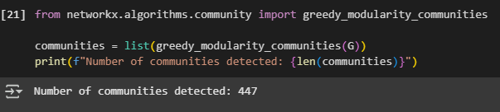
Community Detection
Number of communities detected: 447.
Modularity: 0.941
Implications
Modular Structure
This suggests a relatively high degree of local structure, with many groups of authors collaborating primarily within their own communities.
A high level of collaboration within research subfields. Authors are often working in groups that are not very interconnected with authors in other fields, leading to many small to medium-sized communities.

Slide 34
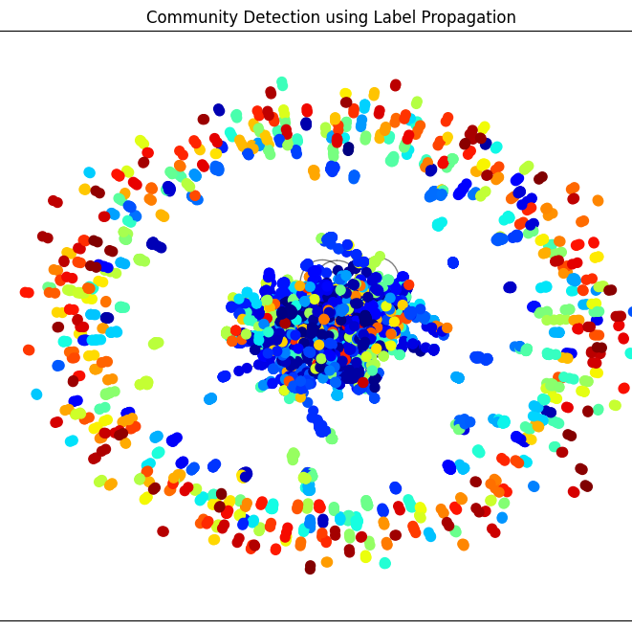
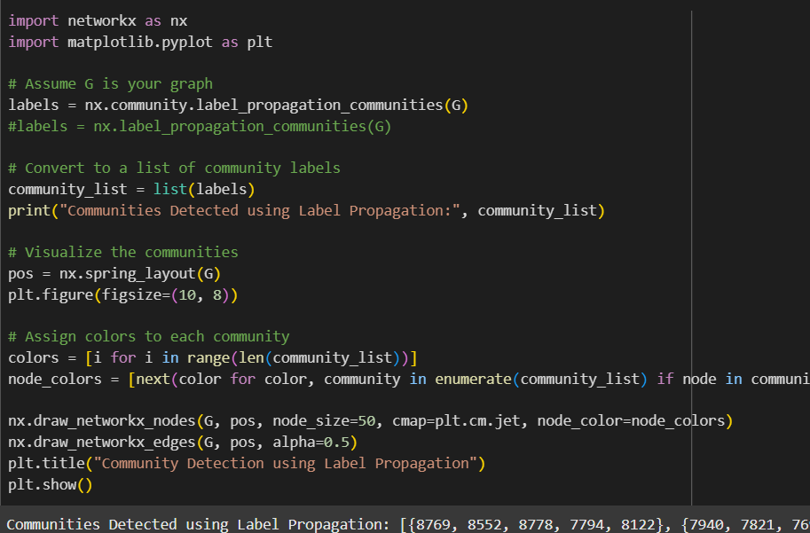
Community Detection
Label Propagation Algorithm
fast and works well with large, sparse networks.

Slide 35
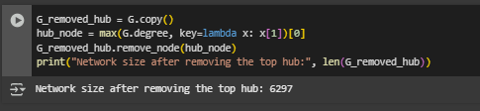
Robustness Analysis (Attack Simulation)
Network size after removing the top hub: 6397
Analysis:
After removing the node with the highest degree (the top hub), the graph has 6297 nodes remaining. This indicates that the top hub had a significant number of connections (or neighbours) and removing it reduces the network size.
Hubs play a central role in maintaining network structure.

Slide 36
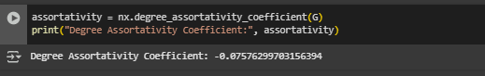
Degree Co-relation
Degree Assortativity Coefficient: -0.07576299703156394
A negative assortativity coefficient of -0.075 suggests that the network exhibits a slight disassortative mixing.
The network has a slight tendency for hubs to connect to less connected nodes, but the effect is not very pronounced

Slide 37
Network Properties
Average Degree: 3.5494357593953825
Network Density: 0.00036751250356133593
Degree Assortativity Coefficient: -0.0729310045604289
Global Clustering Coefficient: 0
Average Clustering Coefficient: 0.0
Number of Connected Components: 443
Largest Connected Component Size: 6397
Graph is not connected. No path length or diameter calculated.
Number of Communities Detected: 484

Slide 38
Presentation Outline
Introduction
Motivation
Contributions
Methodology
Results & Discussion
Conclusion
References

Slide 39
Conclusion
The co-authorship network revealed strong collaboration clusters and influential authors.
The network exhibited characteristics of a scale-free structure, confirmed by the power-law degree distribution Gamma Value (γ) = 3.36
High global clustering coefficient (0.799) indicates a tightly connected collaboration structure
Slight negative degree assortativity (-0.075) implies that high-degree nodes tend to connect with lower-degree nodes.
Network robustness was tested by hub removal, showing fragmentation but maintaining connected components.

Slide 40
Conclusion (Future Work)
Dynamic analysis of evolving collaboration patterns over time.
Incorporation of additional metadata such as research domains or publication impact.
Application of more sophisticated community detection methods.
Incorporate weights based on factors such as publication count, citation impact, or research funding to better understand the strength of collaborations.
Analyze co-authorship networks across different academic disciplines to identify inter-disciplinary trends.

Slide 41
References
[1] Kalhor, Ghazal & Sarijalou, Amin & Sadr, Niloofar & Bahrak, Behnam. (2022). A new insight to the analysis of co-authorship in Google Scholar. Applied Network Science. 7. 10.1007/s41109-022-00460-4.
[2] J. F. Dania, N. Tabassum, A. Nath, M. I. Hossain and S. Sultana, "Research Data Analysis: Academic Research and Collaboration Activities in Bangladesh," 2023 International Conference on Next-Generation Computing, IoT and Machine Learning (NCIM), Gazipur, Bangladesh, 2023, pp. 1-6, doi: 10.1109/NCIM59001.2023.10212552
[3] Jalal, Samir Kumar. "Co-authorship and co-occurrences analysis using Bibliometrix R-package: A casestudy of India and Bangladesh." Annals of Library and Information Studies (ALIS) 66.2 (2019): 57-64.

